Slide 1
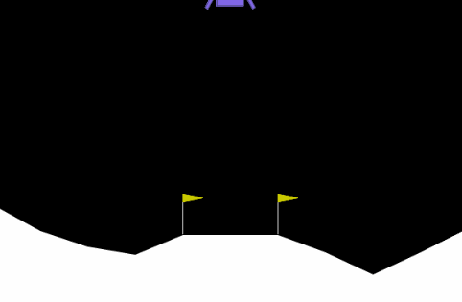
Reinforcement Learning Lab: Lunar Lander Based on Deep Q-Network
Introduction to Artificial Intelligence 2024
Speaker: Jishen Lin
Student ID: 2250758
2024-06-03

Slide 2
1
Introduction to the Experiment
2
Algorithm Overview
Contents
3
Experimental Setup
4
Experimental Results
5
Analysis and Discussion

Slide 3
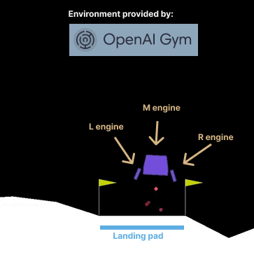
Introduction to the Experiment
1.1 Goal
The goal of the Lunar Lander environment is to land the lunar lander safely on the landing pad on the surface of the moon. The landing pad is designated by two flag poles and its center is at coordinates (0,0) but the lander is also allowed to land outside of the landing pad.
1.2 Starting State
The lander starts at the top center of the environment with a random initial force applied to its center of mass and has infinite fuel.
1.3 Action Space
The action space is discrete:
0: Do nothing
1: Fire left orientation engine
2: Fire main engine
3: Fire right orientation engine
1.4 Observation Space
The state is an 8-dimensional vector:
x coordinate
y coordinate
x velocity
y velocity
Angle
Angular velocity
Boolean for left leg contact with the ground
Boolean for right leg contact with the ground

Slide 4
Introduction to the Experiment
1.5 Rewards Mechanism
For each step, the reward:
Decreased proportionally to the distance to the landing pad
Decreased proportionally to the speed of the lander
Decreases proportionally to the angle with respect to the ground
Increased by 10 points for each leg in contact with the ground
Decreased by 0.03 when side engines are actioned
Decreased by 0.3 when the main engine is actioned
Receives an additional reward of +100 for landing safely
Receives an additional penalty (negative reward) of -100 for crashing the lander
An episode ends:
The lunar lander crashes (body comes in contact with the surface of the moon)
The absolute value of the lander's x-coordinate is greater than 1 (beyond the border)

Slide 5
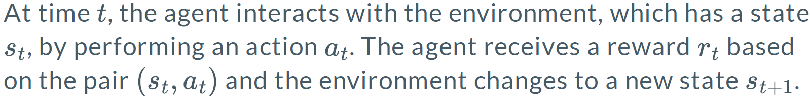
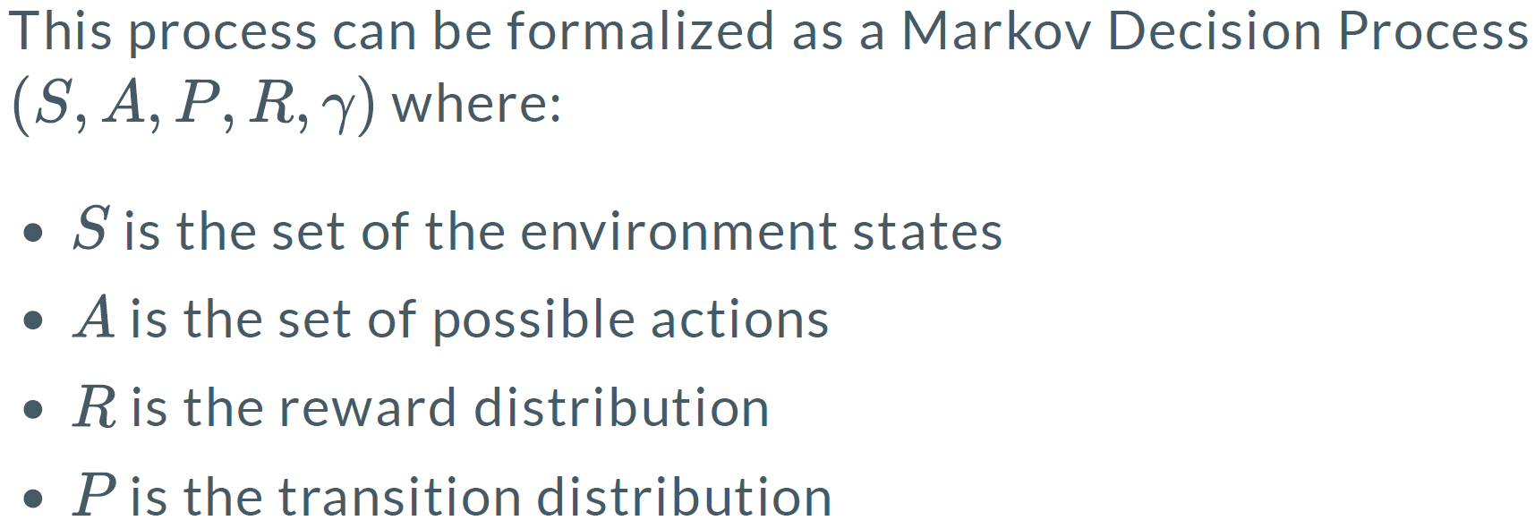
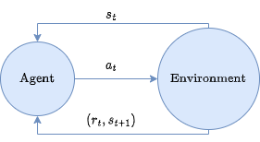
Algorithm Overview
2.1 Reinforcement Learning
2.2 Markov Decision Process

Slide 6
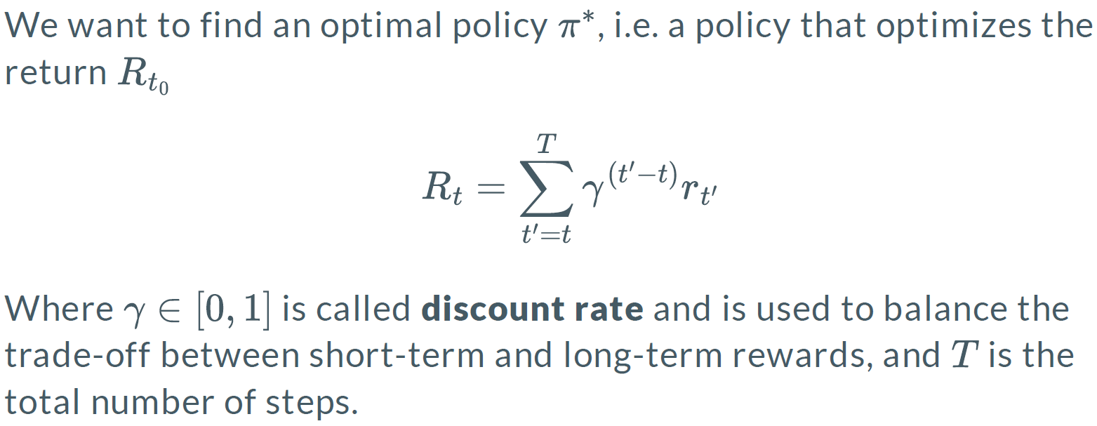
Algorithm Overview
2.3 Policy
2.4 Return

Slide 7
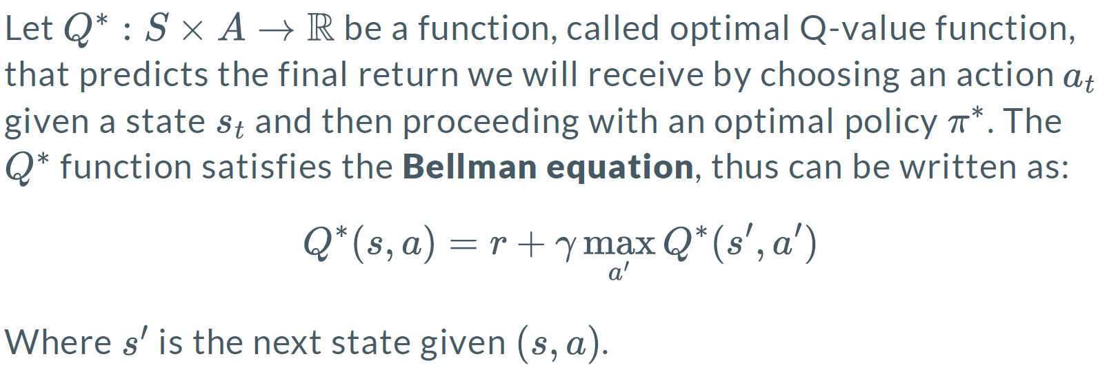
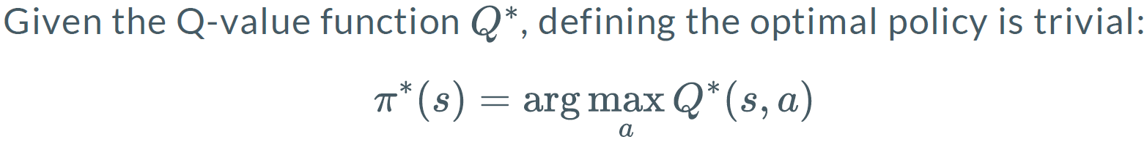
Algorithm Overview
2.5 Optimal Q-Value Function

Slide 8
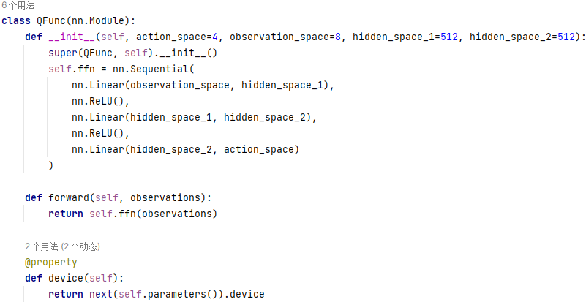
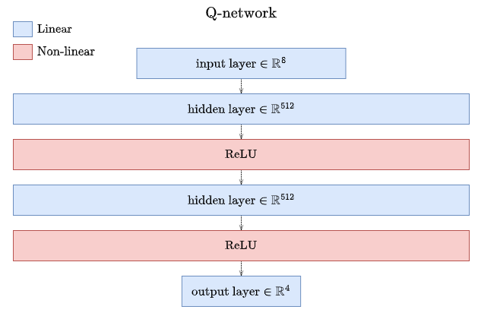
Experimental Setup
3.1 DQN Parameter Settings - Neural Network Architecture

Slide 9
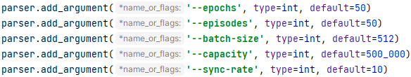
Experimental Setup
3.2 DQN Parameter Settings - Hyperparameter Selection
Epochs: 50
Episodes: 50
Batch size: 512
Replay memory size: 500,000
Sync-rate: every 10 epochs
Optimizer: Adam
Learning rate: 0.001

Slide 10
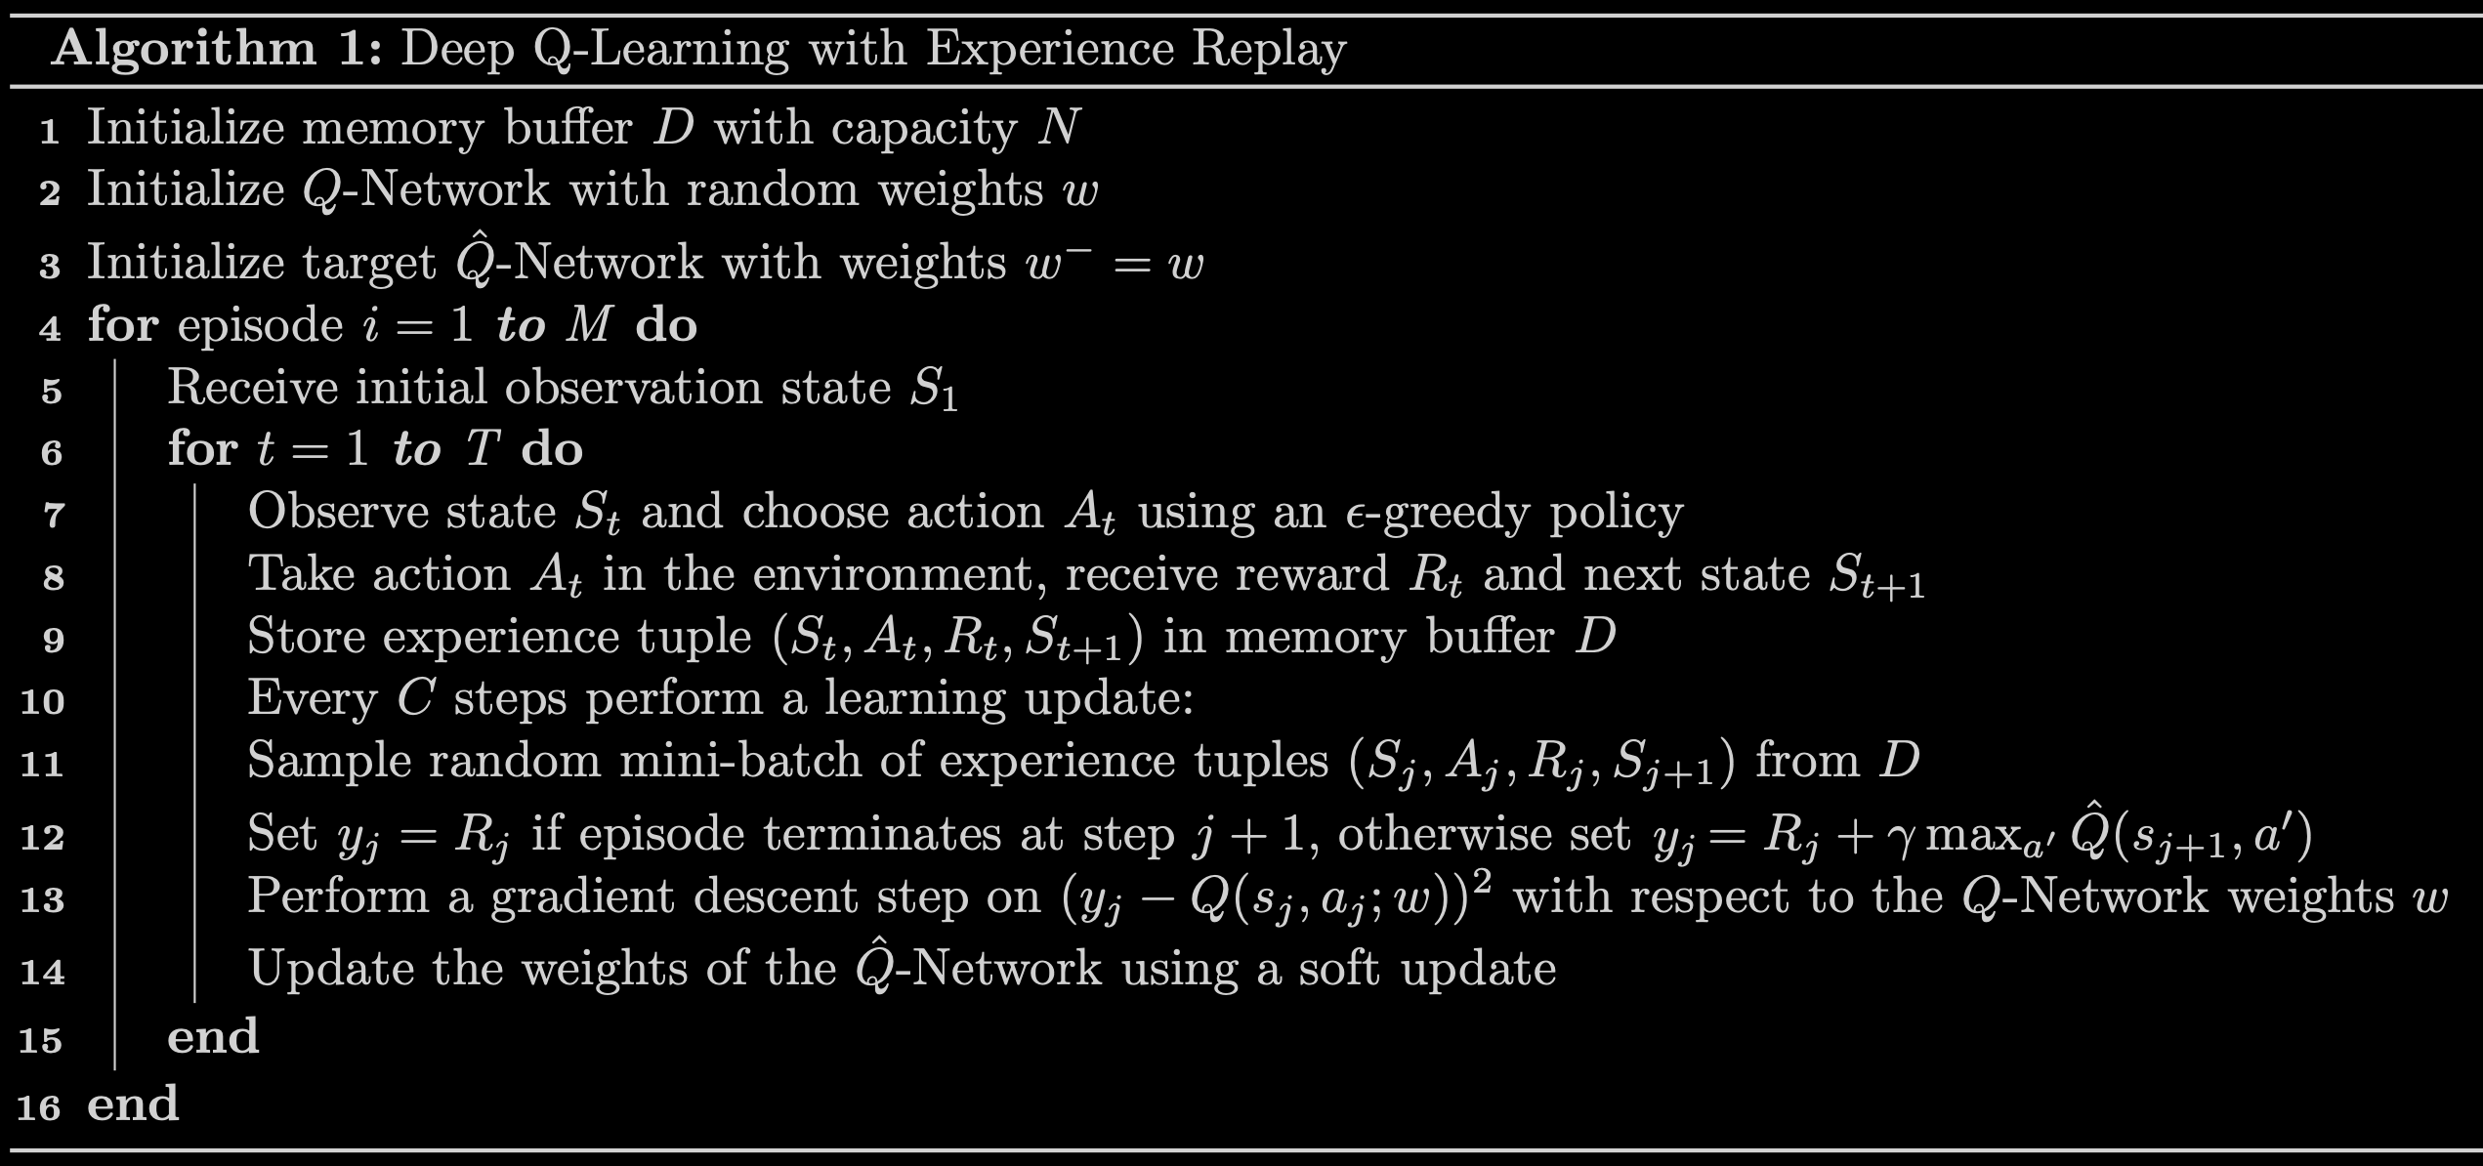
Experimental Setup
3.3 Model Training Process

Slide 11
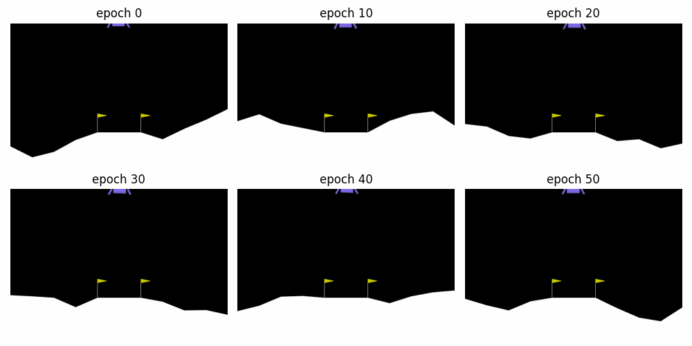
Experimental Results

Slide 12
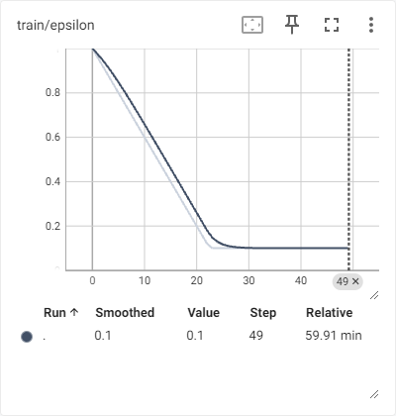
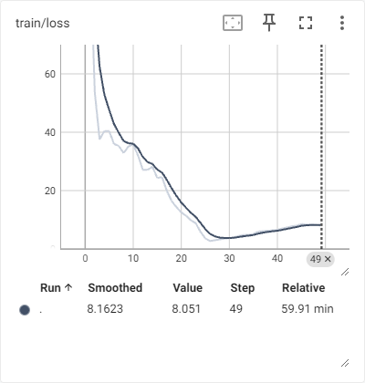
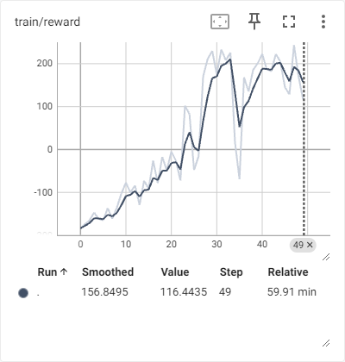
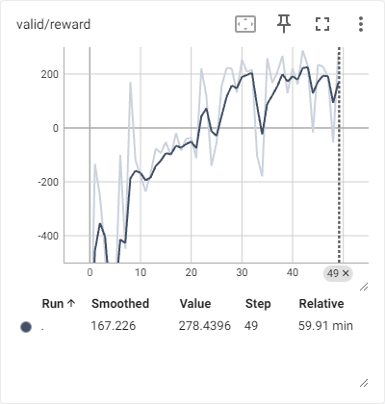
Analysis and Discussion
train / epsilon | train / loss | train / reward | valid / reward
Decline of ε (Exploration Rate) During Training | Training Loss Decrease | Increase in Training Rewards | Validation Rewards
Our reinforcement learning model demonstrated a consistent ability to learn and adapt to the environment during training. The appropriate reduction in ε, the continuous decrease in loss, and the steady increase in rewards all indicate that the model has made progress in the experiment. Additionally, the model's performance during the validation phase suggests it has good generalization capabilities. We can further adjust the training parameters and experiment with different reward structures to optimize the model's performance and stability.

Slide 13
Introduction to Artificial Intelligence 2024
Thanks for Your Listening!
Reinforcement Learning Lab: Lunar Lander Based on Deep Q-Network
Speaker: Jishen Lin
Student ID: 2250758
2024-06-03

